Slide 1
Air Quality Detector (Capstone Project)
Meshal almuhareb
SEIS 744 IoT
Spring 2017

Slide 2
About
Air Quality Detector is an IoT device that measures the air quality based on two main factors:
1- Particle (dust) sensor
2- Combustible gas sensor

Slide 3
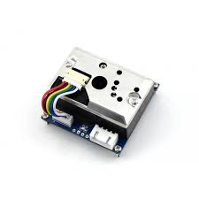
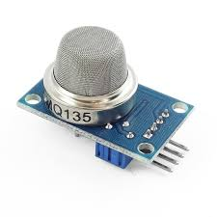
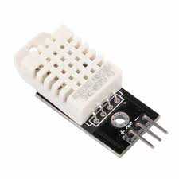
Sensors
Particle(dust) Sensor:
Detect The Particulate Matter level (PM level) in the air is measured by counting the Low Pulse Occupancy time (LPO time) in given time unit.
Gas Sensor:
Detect combustible gas, smoke.
Digital Temperature and Humidity sensor :
DHT22
Notes:
Particulate matter is the sum of all solid and liquid particles suspended in air many of which are hazardous. This complex mixture includes both organic and inorganic particles, such as dust, pollen, soot, smoke, and liquid droplets. These particles vary greatly in size, composition, and origin.

Slide 4
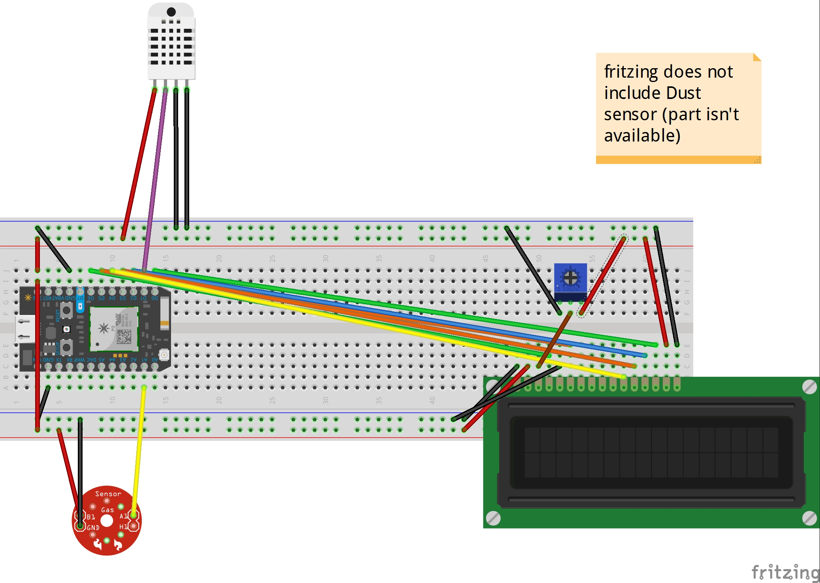
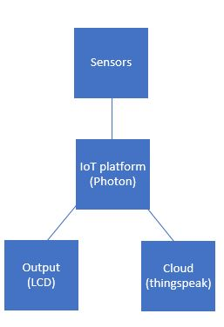
Fritzing & HL system diagram

Slide 5
Benefits
Air Quality Detector is a huge help for people suffering from allergies and respiratory issues to plan their trips accordingly and avoid bad situations
Air Quality Detector is the perfect solutions to keep an eye on the quality of the air in the house

Slide 6
Areas of Improvement
Enchanted Air Purifier
The Air Quality detector is a vital part to automate the air purifier system

Slide 7
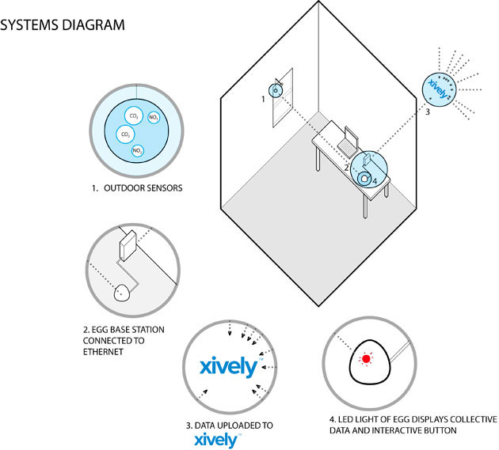
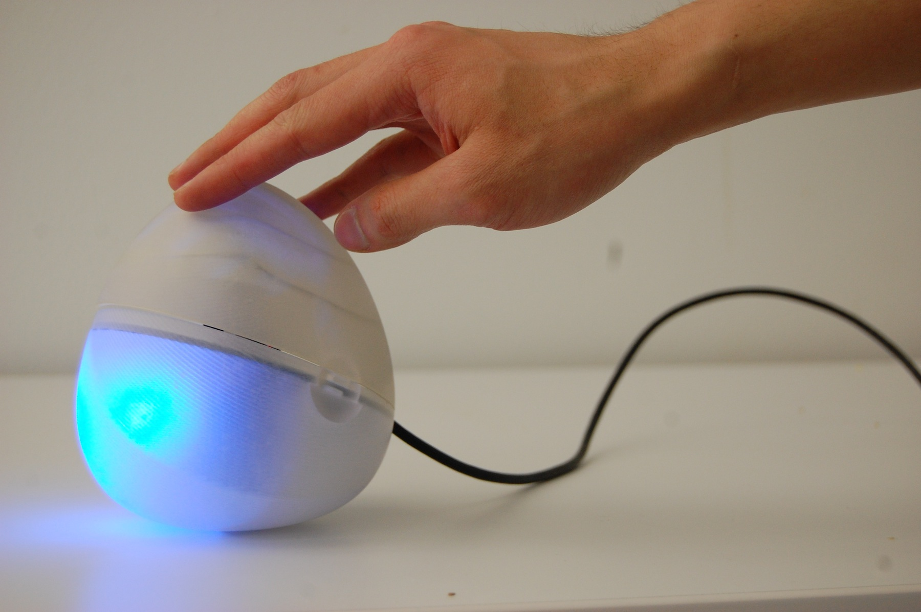
Current Solutions
Air Quality Egg (http://airqualityegg.com/)

Slide 8
ThingSpeak
ThingSpeak public channel:
https://thingspeak.com/channels/270848

